Slide 1
Group 3 Project 1
Jance Ng
Jin Min Wood
Adrian Kong
Notes:
Good afternoon everyone, we’re from group 3. My name is Adrian Kong and I’m with my group mates Jance and Jin Min. Today we’re here to talk about our projects and findings, so without further ado, let’s start with the problem statement of our project.

Slide 2

Problem Statement
Education is important to any country, because it equips people with the skills and knowledges for better job opportunities and thereby boosting the economy. SAT and ACT are used for college admission decisions. Tertiary education being one of the key factors affecting the employability and the future of a person. Department of Education (DOE) is performing analysis on the country's SAT and ACT results to determine which of the states require more resources allocation and focus.
Notes:
Education is very important to any country because it equips ppl with the skills and knowledges for better job opportunities and thereby boosting the economy.Tertiary education is one of the key factors affecting the employability and the future of a student. As the Department of Education, in short let’s call it DOE, it is our duty to help as many students as possible to enter into colleges. DOE is now performing an analysis on the college admission test which are the SAT and ACT to determine which states require more focus and more resources allocation from DOE. Before we start with the analysis, let’s take a look at the score distribution of SAT and ACT from 2017 to 2019.

Slide 3
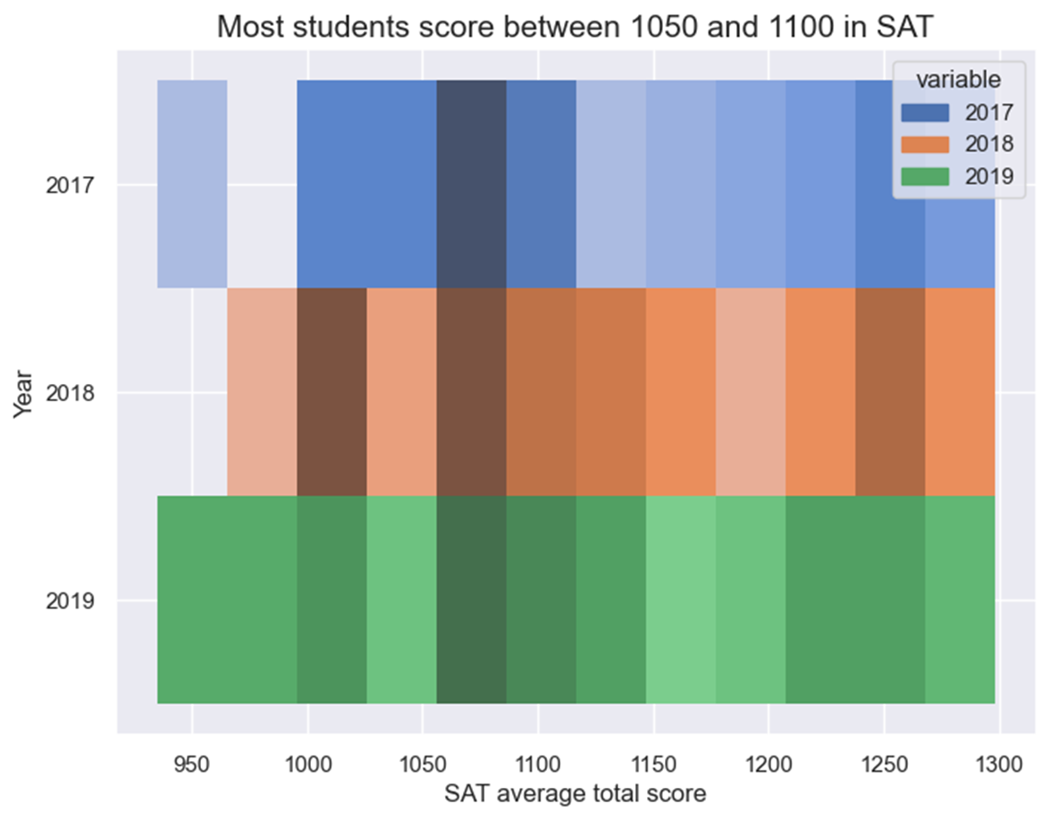
Notes:
This is the score distribution chart of SAT from 2017 to 2019. Let me explain how do we read this chart, the darker the colour means the higher number of states that have average score falls in that particular distribution. For example, let’s take a look at the score of 1250 here, the color is a darker than

Slide 4
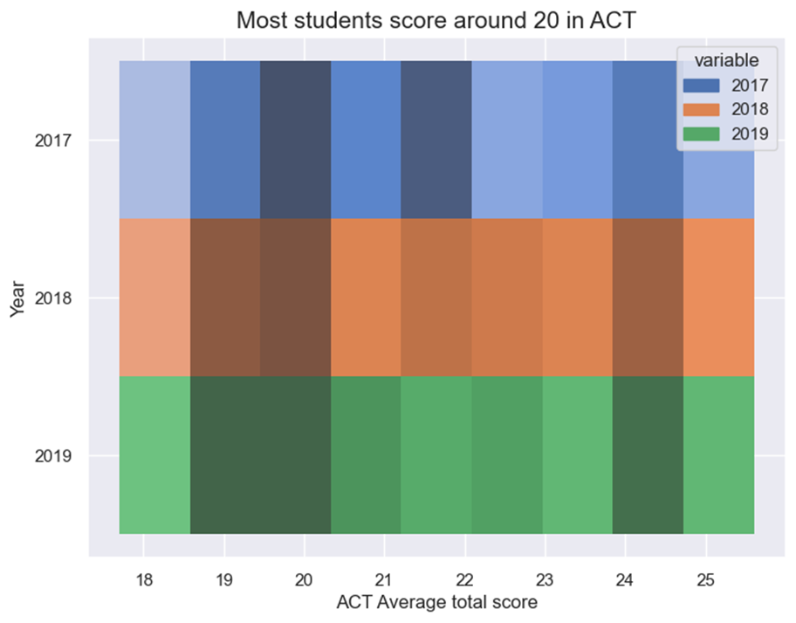

Slide 5
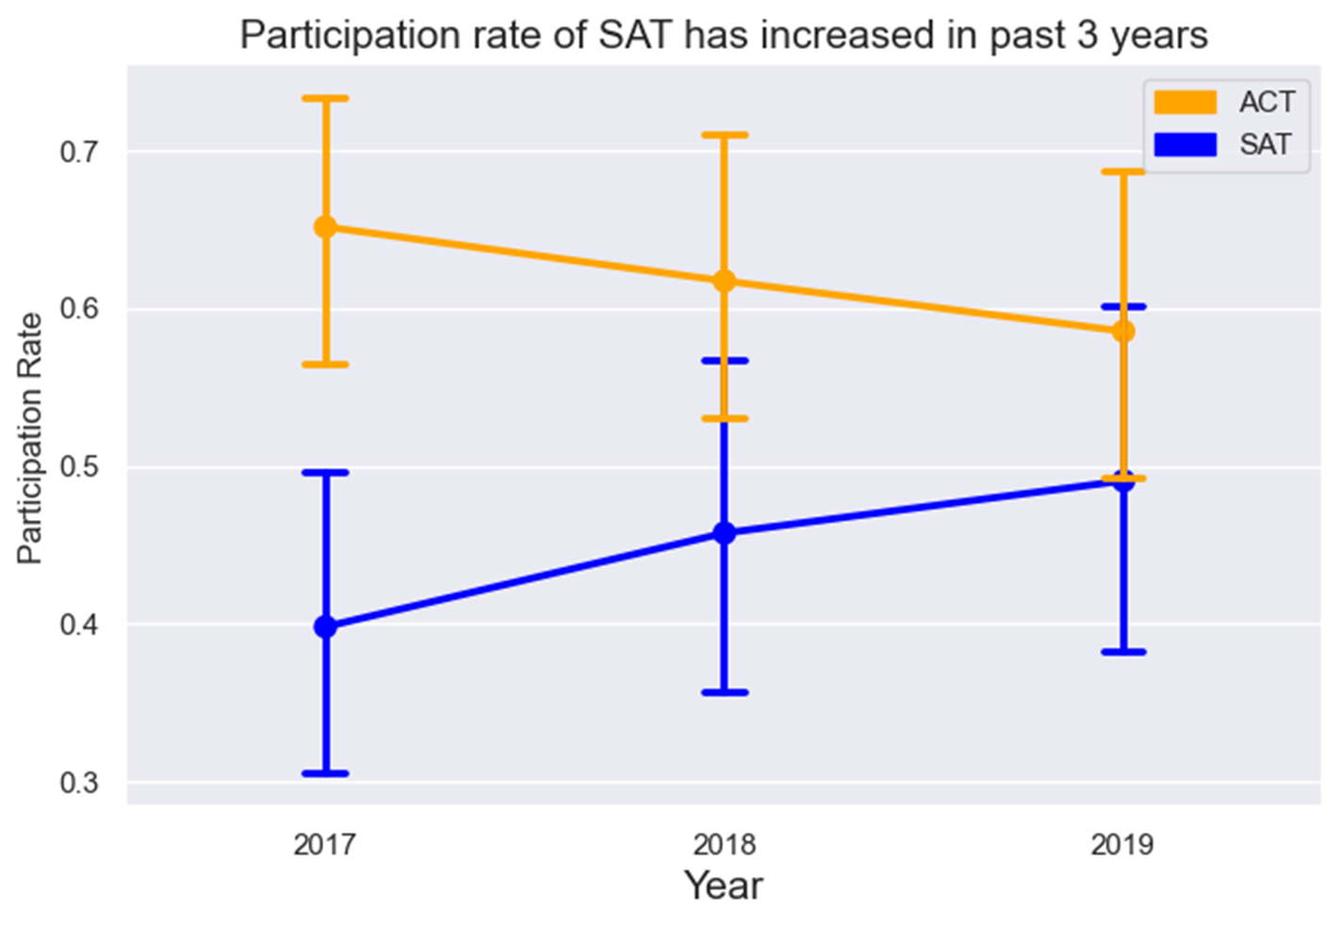
Notes:
Thank you Adrian.
Now let us look at the participation rate of SAT and ACT, and we see that there is an increase in the participation rate for SAT whereas there is a drop in the ACT participation rate.
Just keep this in mind as we move along

Slide 6
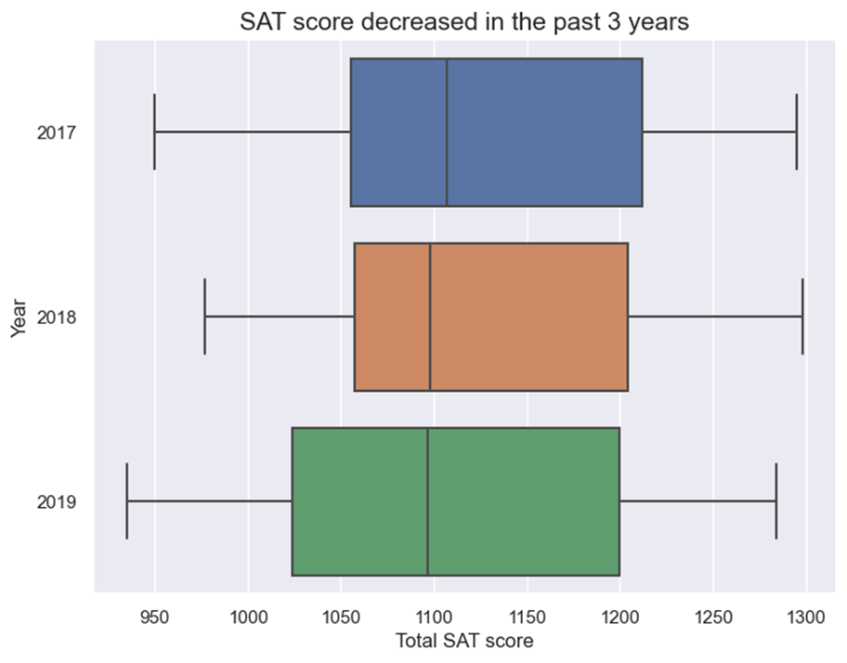
Notes:
In this chart we see the minimum SAT score, the maximum SAT score.
25% of the scores are lesser than this value.
This is the median score where the data is cut into half.
And this is the 75th percentile or in another words, 75% of the score is lesser than this value.
We see that overall there is a drop in the SAT score, and there is no abnormal score observed in the data.

Slide 7
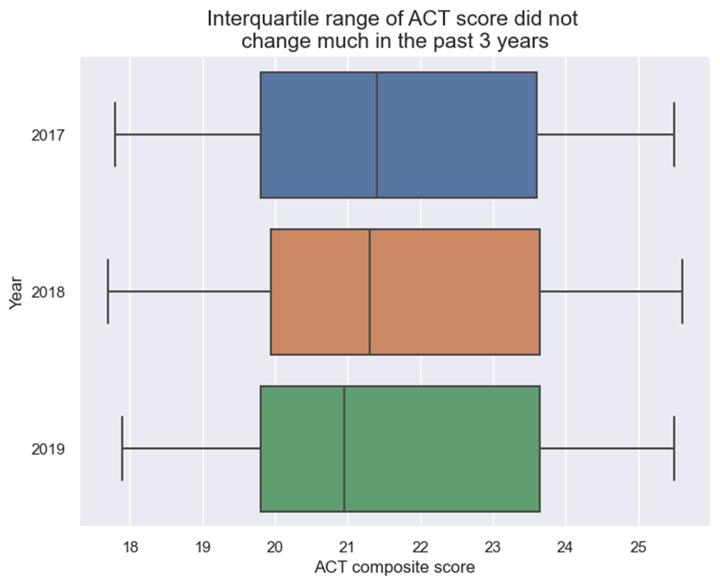
Notes:
We plot the same type of chart for ACT score and see that there is not much change in the ACT scores

Slide 8
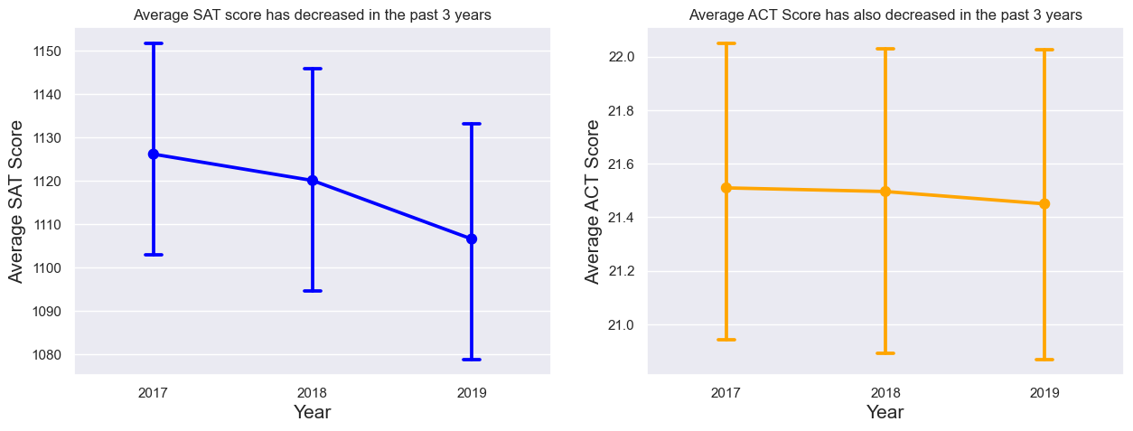
Notes:
This chart shows the average SAT and ACT score over the past three years, and again we see a drop in the average SAT score.
The greater drop observed in SAT score could be due to:
Higher participation rate in SAT vs lower participation rate in ACT, hence likely lesser data collected for ACT score over the years.
Larger range in the SAT score vs ACT, hence a smaller change in the SAT score could be more easily noticed than the ACT score.
More analysis and data is needed to confirm our presumption.

Slide 9
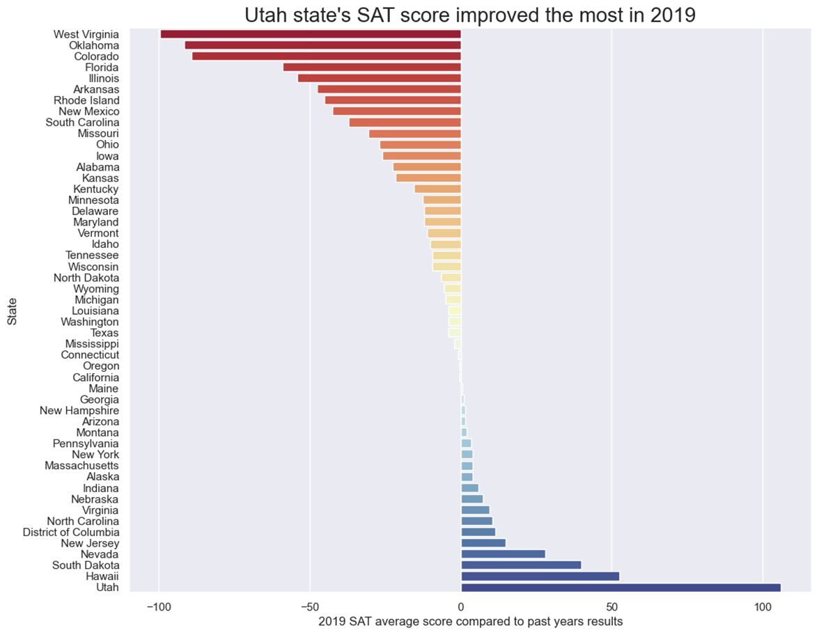

Slide 10
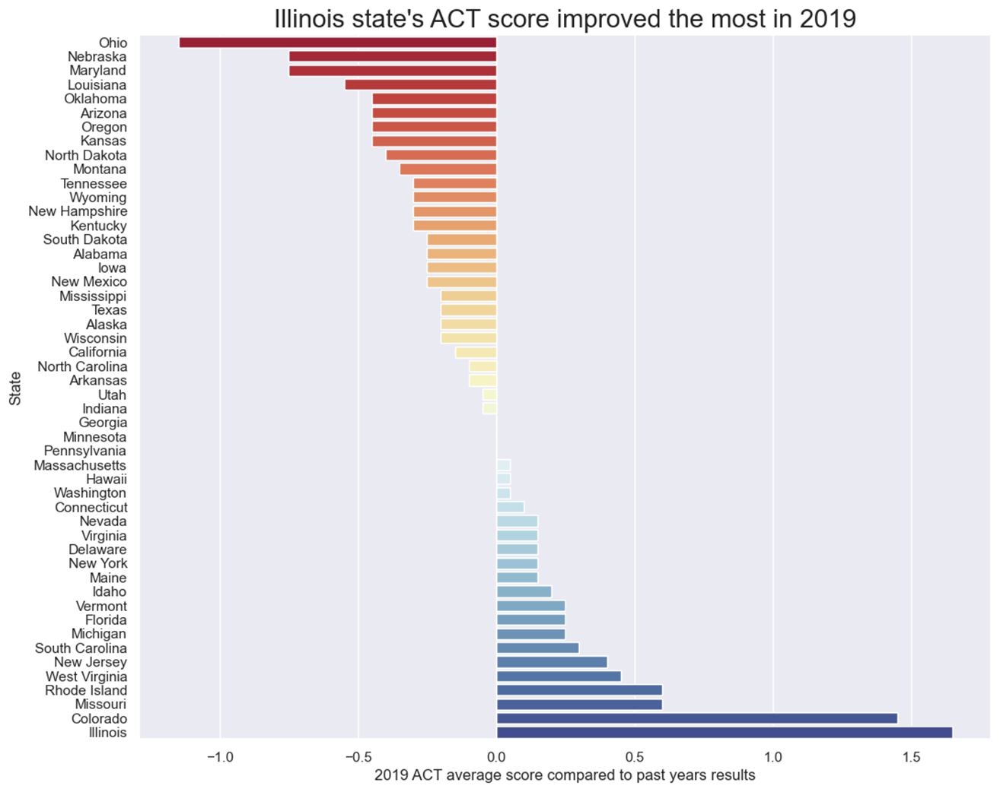

Slide 11
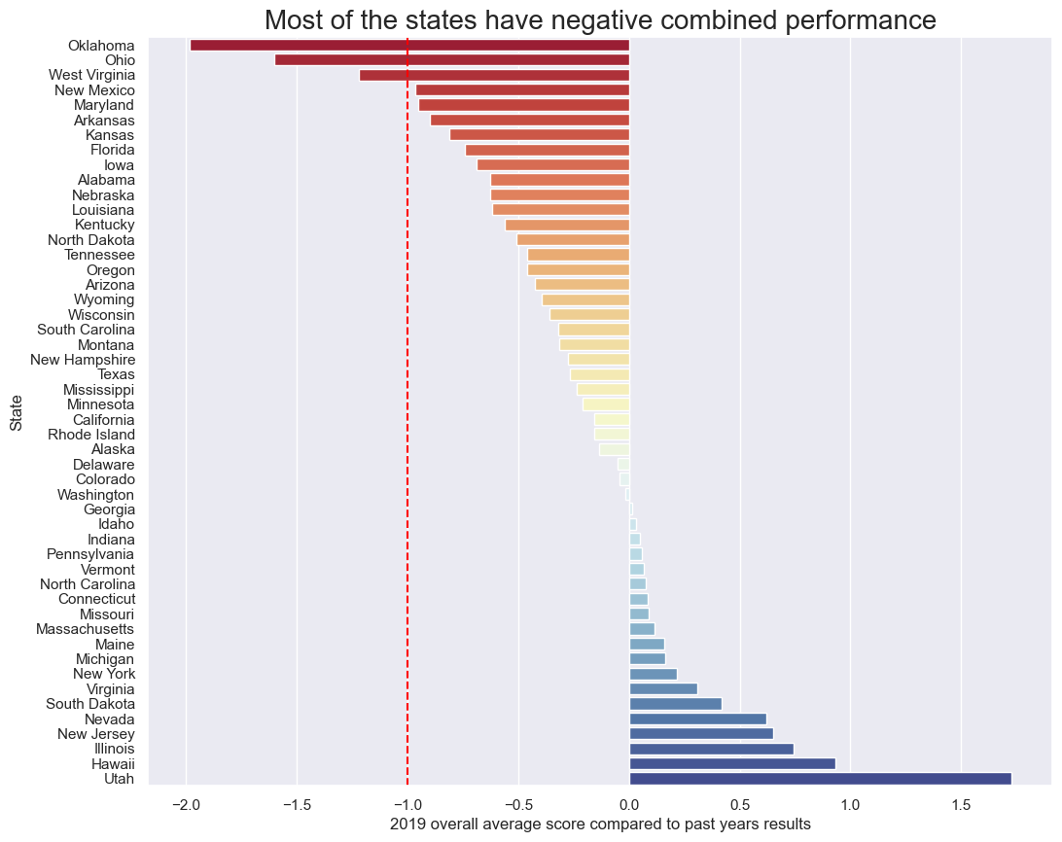

Slide 12
Conclusion
Ideally we would want to put in effort in every state to improve the overall results of the country. However, due to resources constraint, it is advised to focus more of the resources on Oklahoma, Ohio and West Virginia to prevent the results in these states from getting worse.

Slide 13
THANK YOU
Prepared by:
Jance Ng
Jin Min Wood
Adrian Kong

